Slide 1



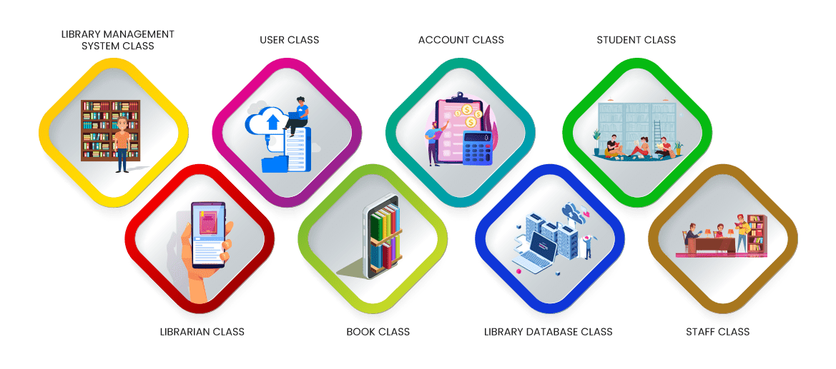
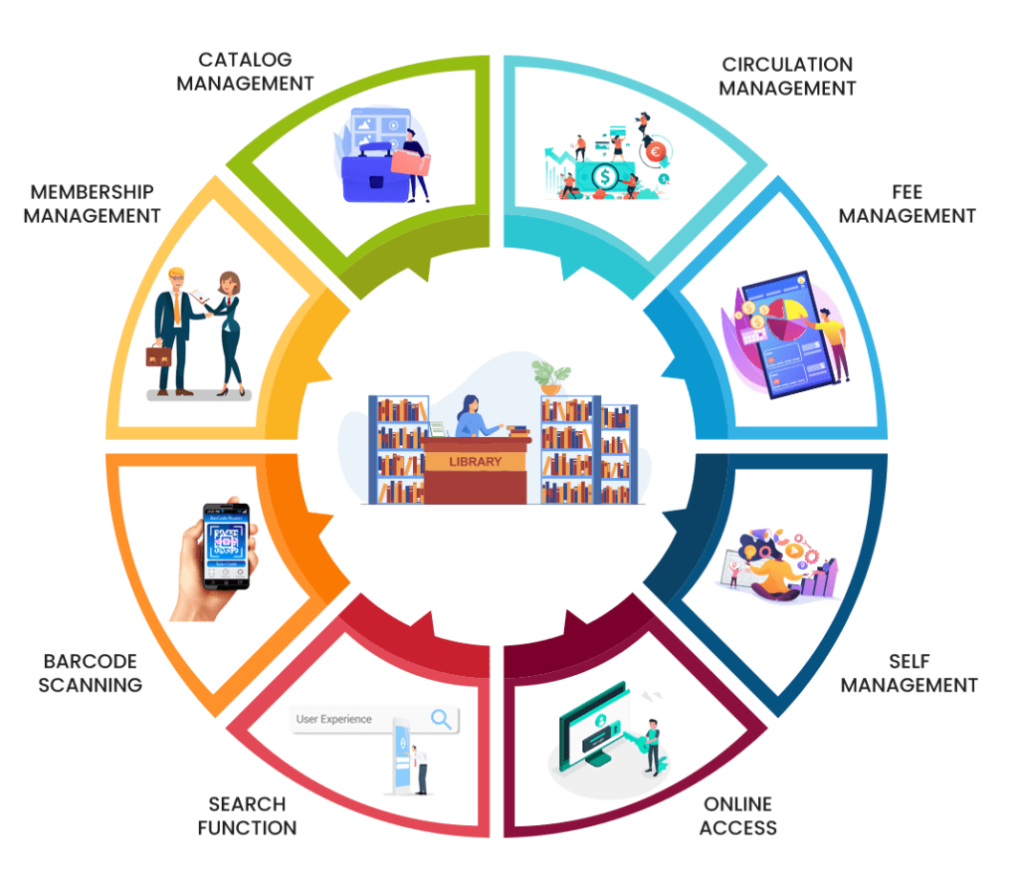

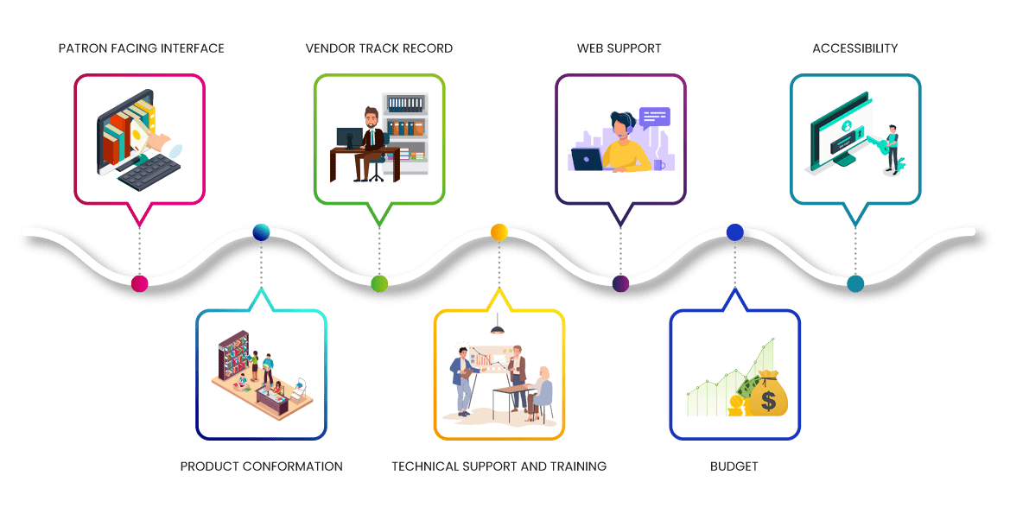
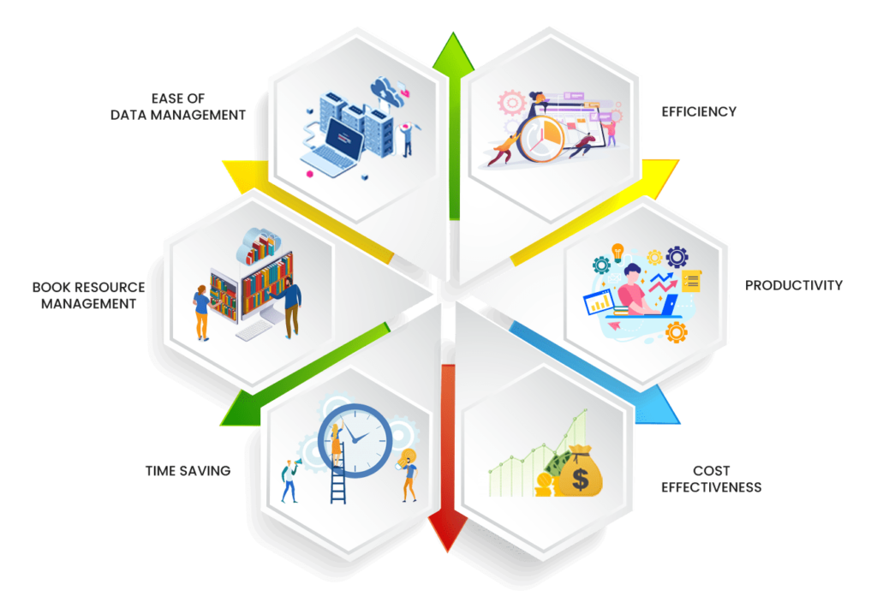
Library Management System
Group – 23
Md. Shakil Hossain (2023)
Mahbubur Rahman (2024)
Nahidul Islam (2028)
ABSTRACT
THE MAIN CLASSES OF OUR LMS
FEATURES OF LMS SOFTWARE
Library management system is a project which aims in developing a computerized system to maintain all the daily work of library. It also has a facility of admin login through which the admin can monitor the whole system. It has a facility where student after logging in their accounts can see list of books issued and its issue date and return date. This system will store all the books and members information that consist book numbers, book titles, author names and racks to the system database.
The library management system software is based on the different sections or classes involved in the operation of a library. The functions and attributes of the classes and relationships between them are specified in a Class Diagram. This diagram forms the fundamental step in building the management software.
Library management system class:
This class manages the entire library management functions and is the focal point on which the software is designed. The attributes of User type and User name with the functions of Register, Login and Logout are vital to any web based library management system.
The best library management system software will have the following features:
Membership management:
to maintain a detailed database of the members. The system records the name, ID and password of each user. The system helps in ascertaining the track record of the member.
Search function:
to enable both the librarian and the members to search the catalog of books in the library. The search functions can be filtered to the need of each user.
Online access:
to catalogues of other public libraries. The web based library management system software provides access to different associate libraries. This broadens the spectrum of search benefitting the user considerably.
Fee management:
to collect membership fees and manage individual member accounts. The software calculates the fine due for non-return or lost and damaged books. The members are intimated of the fines by the system.
INTRODUCTION
A Library Management System (LMS) is a software application designed to help manage and organize library resources such as books, journals, CDs, DVDs, magazines, newspapers, and other multimedia items. The system also helps track the circulation of these materials, manage user accounts, and generate reports.
Some popular LMS systems include Alma, Koha, Sierra, and Voyager. These systems are typically customizable to suit the specific needs of individual libraries.
CHECK-LIST FOR SELECTING A LMS
The selection of the library management system software depends on the type of library that needs to be automated.
Product conformation:
The library management system software has to be one that can manage the entire work of the library. The software should be flexible to suit the needs of the library. Primarily the work of the librarian and that of the other staff have to be addressed by the system.
Vendor track record:
The library has to do a check of the vendor and his capabilities prior to buying. The provider has to demonstrate the product to the users. The vendor has to install the library management system software on the computers in the library.
Technical support and training:
The provider should be able to train the end users to competently operate the system. They have to ensure prompt service for technical hitches that might occur. Training for the staff has to be provided when the software is updated.
Accessibility:
The system should allow the school libraries to manage their student base from a central system accessible from anywhere, anytime. It should be possible for management to view the library operations from anywhere. The program should be accessible from libraries, classrooms, computer labs, homes and any place with an internet connection or web access.
Budget:
The cost of the library management system software depends on the features it offers. It is best to list out exactly what functions have to be managed to reduce the cost of purchase.
PROBLEM STATEMENT
The problem occurred before having computerized system includes:
• File lost:
when computerized system is not implemented file is always lost because of human environment. Sometimes due to some human error there may be a loss of records.
• File damaged:
When a computerized system is not their file is always lost due to some accident like spilling of water by some member on file accidentally. Besides some natural disaster like floods or fires may also damage the files.
• Difficult to search record:
When there is no computerized system there is always a difficulty in searching of records if the records are large in number. Space consuming after the number of records become large the space for physical storage of file and records also increases if no computerized system is implemented.
• Cost consuming:
As there is no computerized system to add each record paper will be needed which will increase the cost for the management of library.
LIMITATIONS
Limited Interactivity
Lack of Customization
Limited Feedback
Limited Integration
Expensive
Technical issues
A
B
CONCLUSION
This website provides a computerized version of library management system which will benefit the students as well as the staff of the library.
It makes entire process online where student can search books, staff can generate reports and do book transactions. It also has a facility for student login where student can login and can see status of books issued as well request for book or give some suggestions. It has a facility of teacher’s login where teachers can add lectures notes and also give necessary suggestion to library and also add info about workshops or events happening in our college or nearby college in the online notice board.
REFERENCES
[1] Software Engineering 10th Edition by Ian Sommerville.
[2] A. Roy, “On E-Library Management System.” Available: https://www.daitm.org.in/wp-content/uploads/2019/04/Gr.-06library-project-report.pdf /[Last access on 25/3/2023]
[3] anurag. “Library Management System | Library Management Software in India.” SkoolBeep, 21 Dec. 2020, www.skoolbeep.com/blog/library-management-system/. /[Last access on 25/3/2023]

